Slide 1
Data Visualization for Finance Analysis
By: Aditya K
Akash SM
Aryan Agrawal Avinash GK Devansh Gupta M
Druvraaj

Slide 2
Contents
Introduction
Implementation
Applications
Code
Output

Slide 3
Introduction
Data visualization is the process of transforming raw data into visual formats like charts and graphs to simplify complex information.
It helps identify patterns, trends, and insights, making data easier to understand and interpret.
Widely used in business, research, and decision-making, effective visualization enhances communication and drives informed strategies.
This presentation explores its importance, types, and best practices for impactful visual storytelling.

Slide 4
Implementation
Data visualization in Python is implemented using libraries like Matplotlib, Seaborn, and Plotly.
Matplotlib provides basic plotting functions, while Seaborn enhances visualization with built-in themes and statistical insights. Plotly enables interactive charts for better data exploration.
The process involves importing libraries, loading data (e.g., using Pandas), and choosing the right visualization method, such as bar charts, line plots, or scatter plots.
For example, plt.bar() in Matplotlib creates bar charts, while sns.barplot() in Seaborn offers a more polished look. These tools help transform raw data into meaningful insights.

Slide 5
Applications
Risk Analysis – Identifies potential financial risks using heat maps and trend charts.
Portfolio Management – Helps investors track asset allocation and performance.
Fraud Detection – Detects unusual transaction patterns with anomaly detection charts.
Market Trend Analysis – Uses line charts and candlestick charts to monitor stock price movements.
Financial Dashboards – Displays real-time financial KPIs for decision-making.

Slide 6
Applications
Revenue & Expense Tracking – Visualizes cash flow, profit margins, and expenditures.
Economic Indicators – Presents inflation rates, GDP growth, and interest rate trends.
Algorithmic Trading – Uses visual insights to optimize trading strategies.

Slide 7
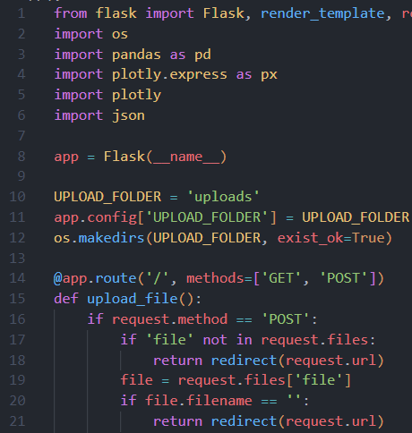
Code:
Library | Definition & Purpose
Flask | Used for creating web applications and APIs
Pandas | Used for efficient data analysis, manipulation, and handling of structured data
Plotly | Used for creating interactive and visually appealing data visualizations
Json | Used for working with JSON data, allowing you to encode (convert objects to JSON format) and decode (parse JSON strings to Python objects) data efficiently

Slide 8
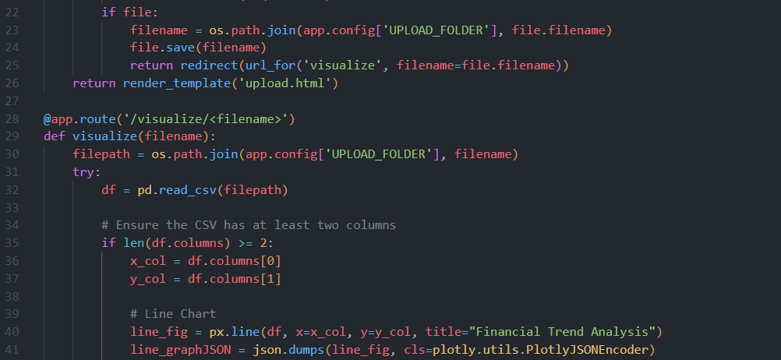
Continued-
@app.route() is used to define the routes for the web application—essentially, mapping URLs to specific functions in the code (here accepting filename as a parameter).
The code is also checking if the provided CSV file as a minimum number of columns.
line(): used to create line charts.

Slide 9
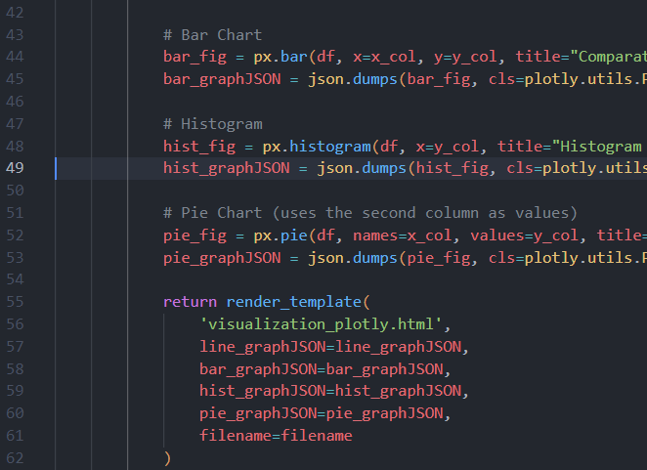
Continued-
bar(): used to create bar charts.
histogram(): used to create histograms.
pie(): used to create pie charts.

Slide 10
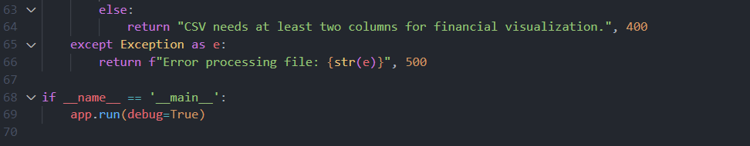
Continued-

Slide 11

Output:

Slide 12
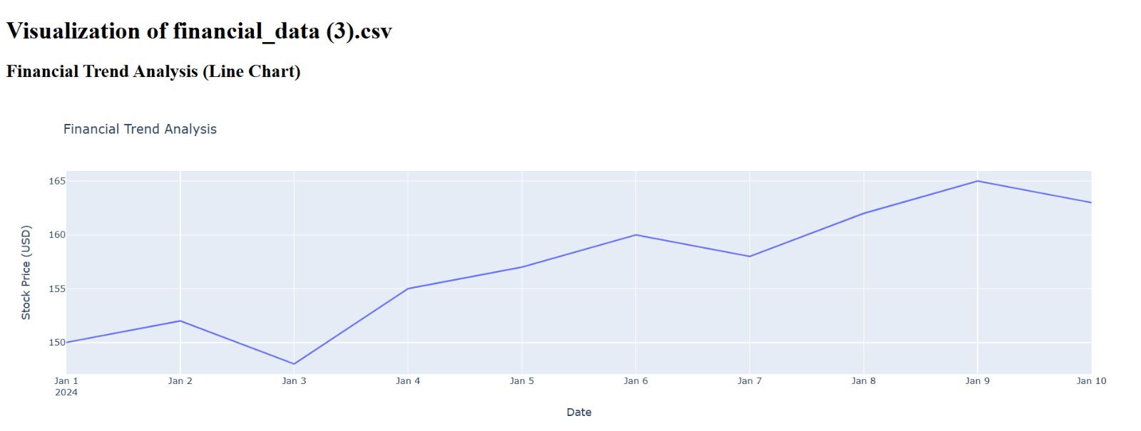
Output:
Line Chart:

Slide 13
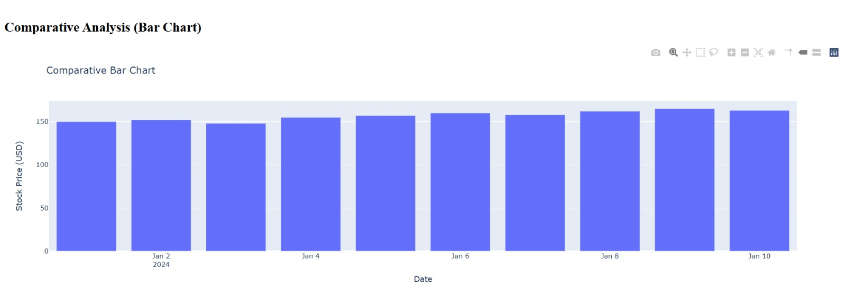
Output:
Bar Chart:

Slide 14
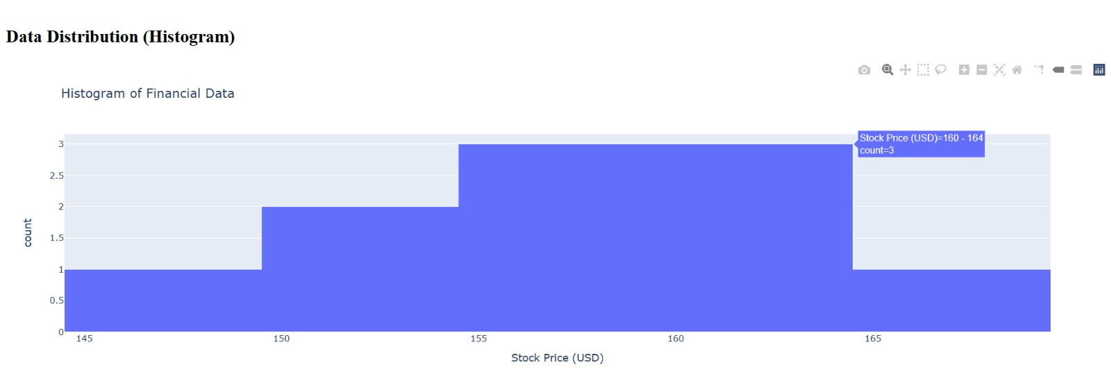
Output:
Histogram:

Slide 15
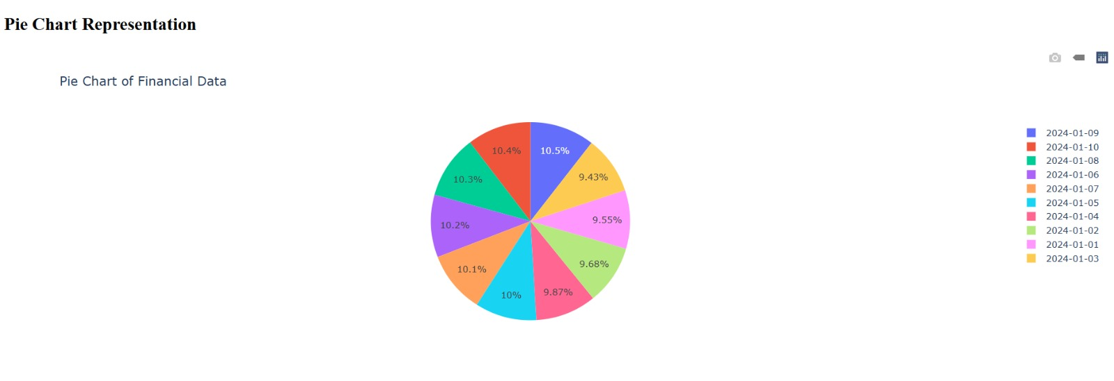
Output:
Pie Chart:

